Slide 1
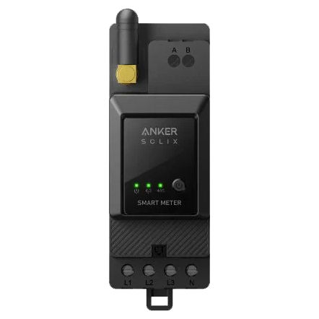
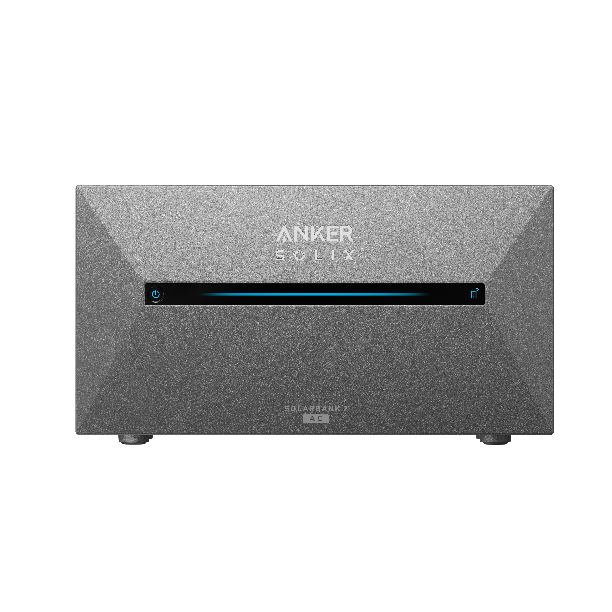
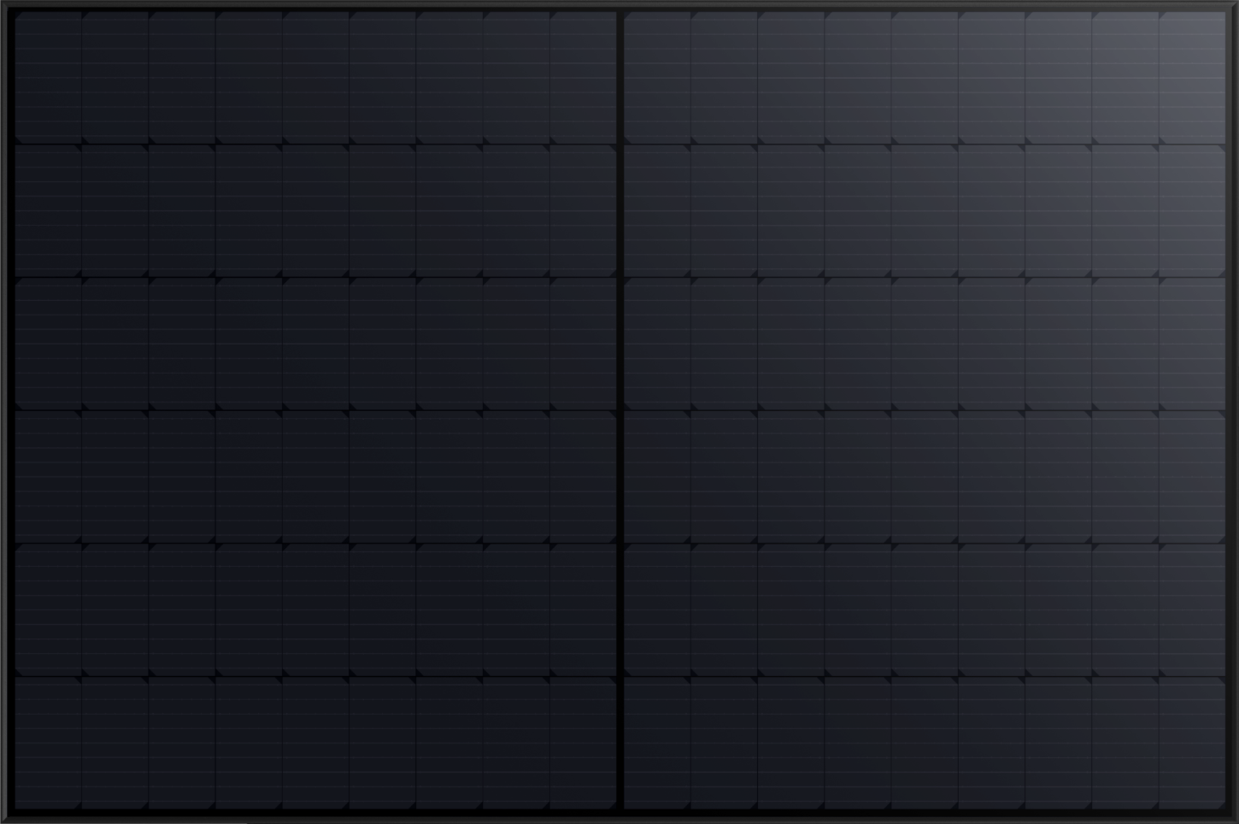


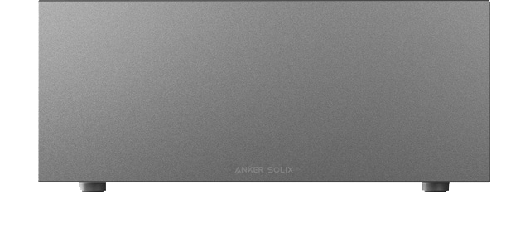

https://anker-in.feishu.cn/docx/CXb9dsdD4o6pR4xC2lLc6SvZnpd
Solarbank 2 E1600 Pro
Solarbank 2 E1600 AC
  100% Home Power, Zero to Grid
The Solarbank 2 series now meets compliance requirements in all European countries where the product is sold.
When connected with Anker SOLIX Smart Meter, zero feed-in can be achieved to avoid using grid power.
Smart Meter¹
Solar Panels
Monitor home loads in real time and make adjustments. Solarbank 2 changes discharging within 3 seconds.
Solar power is adjusted according to bypass requirements to avoid sending energy to the grid.
Solarbank 2
Discharge power according to real-time needs, ensuring you have 100% self-consumption of energy.
¹The zero feed-in feature requires Anker SOLIX Smart Meter. In Italy, Solarbank 2 only supports 350W discharging without a smart meter. For countries with feed-in restrictions (Poland, Hungary, Czechia, Slovakia, Romania, Sweden, Norway), a smart meter is required. For other countries, contact our support team for details.
This feature requires a software version of at least 1.0.5.25.
Images and configuration are for demonstrative purposes only. Refer to the product manual for the most accurate information.

Slide 2





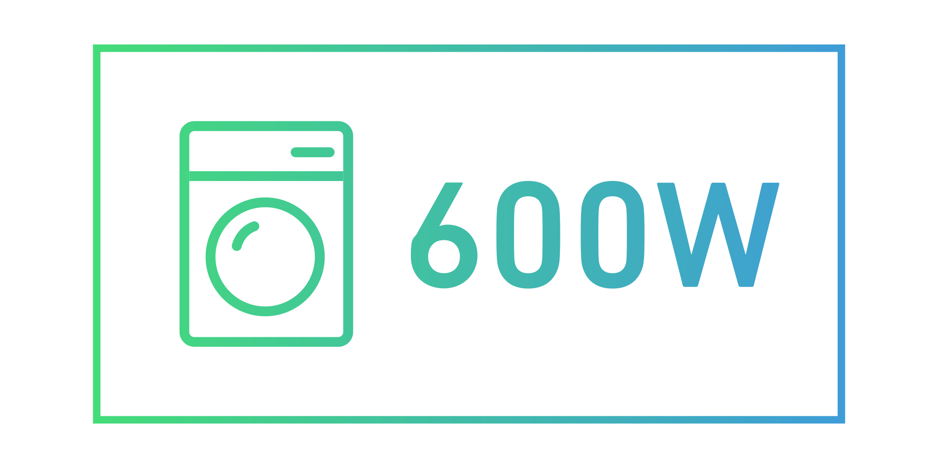
https://anker-in.feishu.cn/docx/CXb9dsdD4o6pR4xC2lLc6SvZnpd
Solarbank 2 E1600 Pro
Solarbank 2 E1600 AC
  100% Home Power, Zero to Grid
The Solarbank 2 series now meets compliance requirements in all European countries where the product is sold.
When connected with Anker SOLIX Smart Meter, zero feed-in can be achieved to avoid using grid power.
Smart Meter¹
Solar Panels
1,200W
600W
600W
Solarbank 2
¹The zero feed-in feature requires Anker SOLIX Smart Meter. In Italy, Solarbank 2 only supports 350W discharging without a smart meter. For countries with feed-in restrictions (Poland, Hungary, Czechia, Slovakia, Romania, Sweden, Norway), a smart meter is required. For other countries, contact our support team for details.
This feature requires a software version of at least 1.0.5.25.
Images and configuration are for demonstrative purposes only. Refer to the product manual for the most accurate information.

Slide 3
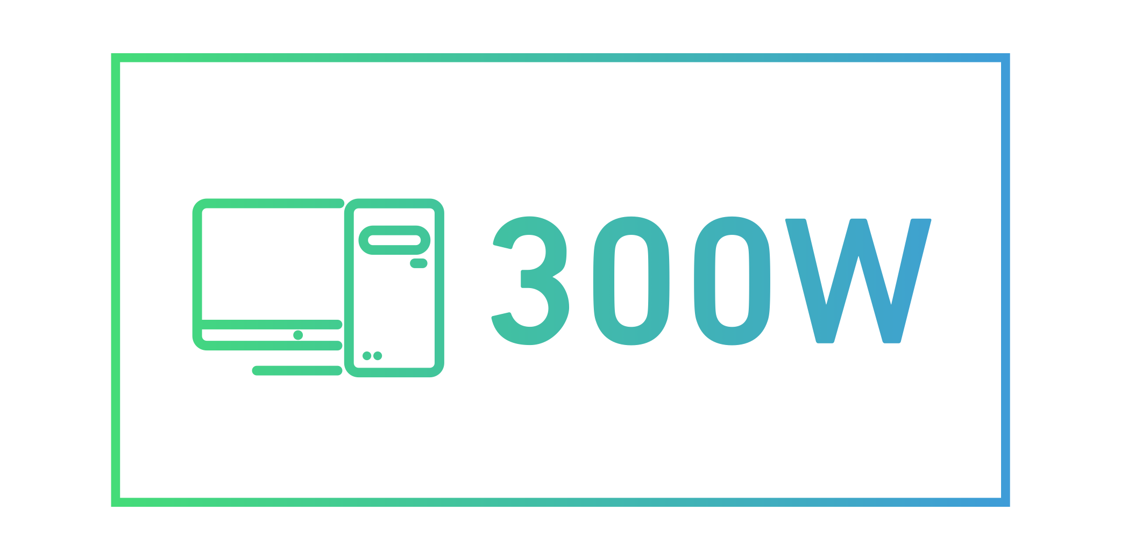
https://anker-in.feishu.cn/docx/CXb9dsdD4o6pR4xC2lLc6SvZnpd
Solarbank 2 E1600 Pro
Solarbank 2 E1600 AC
  100% Home Power, Zero to Grid
The Solarbank 2 series now meets compliance requirements in all European countries where the product is sold.
When connected with Anker SOLIX Smart Meter, zero feed-in can be achieved to avoid using grid power.
Smart Meter¹
Solar Panels
Dynamic solar tracking
based on home use needs
1,200W
600W
600W
Solar Bypass
Full Capacity
Solarbank 2
¹The zero feed-in feature requires Anker SOLIX Smart Meter. In Italy, Solarbank 2 only supports 350W discharging without a smart meter. For countries with feed-in restrictions (Poland, Hungary, Czechia, Slovakia, Romania, Sweden, Norway), a smart meter is required. For other countries, contact our support team for details.
This feature requires a software version of at least 1.0.5.25.
Images and configuration are for demonstrative purposes only. Refer to the product manual for the most accurate information.

Slide 4
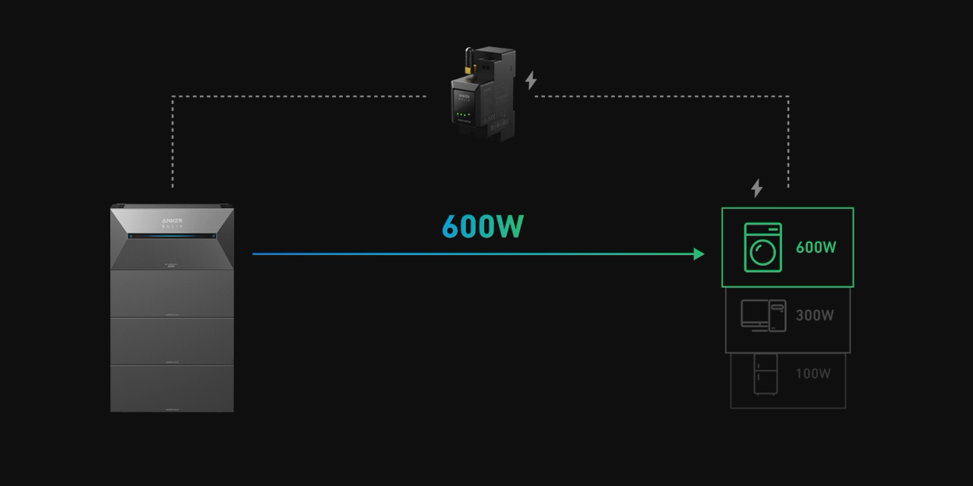

Zero Output
to the Grid
https://anker-in.feishu.cn/docx/CXb9dsdD4o6pR4xC2lLc6SvZnpd
Solarbank 2 E1600 Pro
Solarbank 2 E1600 AC
  100% Home Power, Zero to Grid
The Solarbank 2 series now meets compliance requirements in all European countries where the product is sold.
When connected with Anker SOLIX Smart Meter, zero feed-in can be achieved to avoid using grid power.
Smart Meter¹
Solar Panels
Dynamic solar tracking
based on home use needs
Zero
Feed-In
300W
600W
300W
600W
Solarbank 2
¹The zero feed-in feature requires Anker SOLIX Smart Meter. In Italy, Solarbank 2 only supports 350W discharging without a smart meter. For countries with feed-in restrictions (Poland, Hungary, Czechia, Slovakia, Romania, Sweden, Norway), a smart meter is required. For other countries, contact our support team for details.
This feature requires a software version of at least 1.0.5.25.
Images and configuration are for demonstrative purposes only. Refer to the product manual for the most accurate information.

